Slide 1

Equifax Cybersecurity Proposal
Dawn Inman
CYB-348-Z1

Slide 2
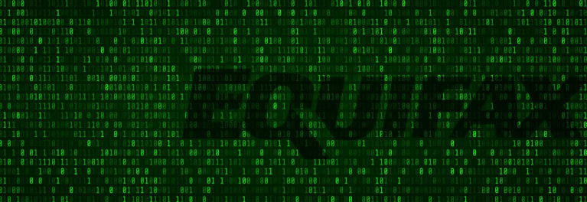
Equifax is in the business of information Data, Analytics, Marketing, Technology, Security, Governance, Compliance and More.
Before the Breach:
What was going well
What was lacking
Record Levels of Financials
Largest Acquisition for Equifax
Investment into I.T. Platforms
Consumer confidence was high
(Equifax, 2016)
Comprehensive Asset Inventory
List of Responsible I.T. Personnel
Complete Follow through on I.T. Audit findings
Patch and Configuration Management Not Designed for Timely Security
Global and Regional I.T. Didn’t Match
Cyber Incident Planning
Threats and Vulnerabilities needed Management attention
Corporate Strategy did not include I.T. Security
(U.S. Senate Subcommittee, 2018)

Slide 3

Presumed Cost of Data vs. Real Cost of Data
Previous Data Cost Presumptions
Data Breach Cost = True Cost of Data
$125 Million Insurance against breach
$51 Million Intangibles including consumer data
$1 Billion in Current Technology and Equipment Assets
(Equifax, 2018), (U.S. Senate Subcommittee, 2018)
$380 Million Non-Reversionary Fund
$125 Million Possible addition to Fund
$1 Billion Mandatory Data Security and Tech Improvements
$2 Billion Probable in Future Credit Monitoring Services
$200 Million Possible Attorney Fees
Total cost of breach over $3.5 Billion

Slide 4
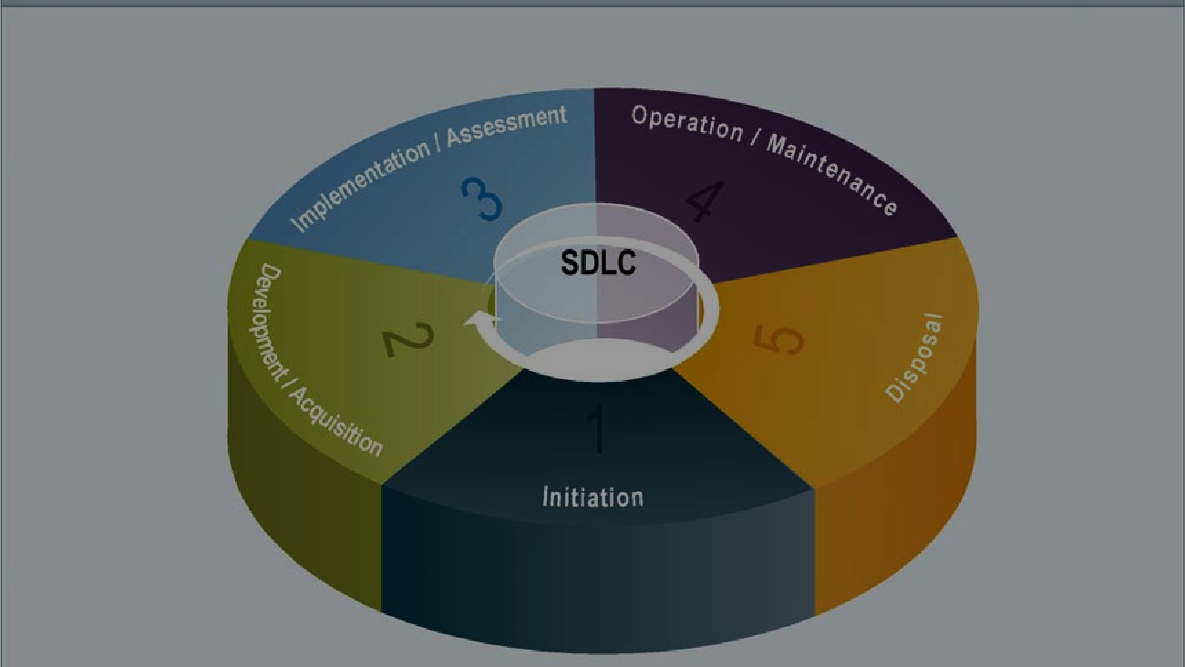
Moving forward after the Breach: Step by Step Information Technology Risk Management Lifecycle
Initiation- Aligns corporate strategy with confidentiality, integrity, availability and accountability I.T. Security is looked at in terms of Business Risks. Policies and Requirements are implemented
Development and Acquisition- Risk assessment and design of security architecture and plans. Systems and programming purchased and constructed.
Implementation and Assessment- Configure and enable systems, test functionality, design reviews and perform system tests. Security and acceptance checks performed on new controls or added systems and documentation and updating of all official system test records, as well as maintaining documentation.
Operations and Maintenance- Systems are continuously monitored, system modifications are incorporated and documented, information systems receive continual upgrades including hardware, software, firmware and environment with documentation of changes and impact essential for monitoring and preventing system lapses.
Disposal- Plans for a new system or total rebuild of system; Plans for discarding hardware, software, and data; Information transposed to new system, archived, discarded or destroyed; Considerations for future retrieval and security of sensitive data; Orderly termination of systems while preserving vital information. (NIST, 2008)
Risk Management is a Continuous Cycle

Slide 5
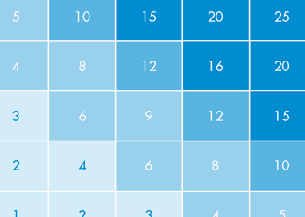
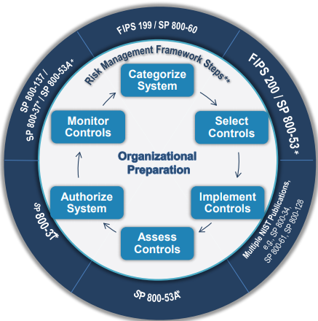
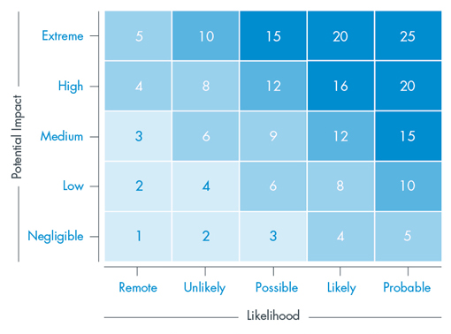
Risk Assessment
Risk identification, Assessment and Categorization of the Risk Matrix fits together with the Risk Management Framework (at left) and the I.T. Risk Management Lifecycle.
(NIST, 2018)
How Identify Risk
How to Categorize Risk
Enter the risks into a Risk Matrix using the Qualitative Values of each risk.
(NIST, 2012)
The Apache Struts risk would have been in the High or Extreme Category for Impact and the Probable Category for Likelihood, making it a 20 or above on the Matrix.
Using tiers and risk assessment scales from NIST 800-30 Appendix I to customize the Qualitative Values of Each Risk.
Ex. Finding out about a patch for software or hardware like Apache Struts (U.S. Senate, 2018)
A Risk Matrix helps determine the final risk exposure level of the Identified Risk. This provides a Standardized Reference Point for making decisions about accepting risks or approving exceptions. (Wheeler, 2011)
Apache Struts was over looked but other issues were as well. The Matrix can help show what issues are highest risk

Slide 6
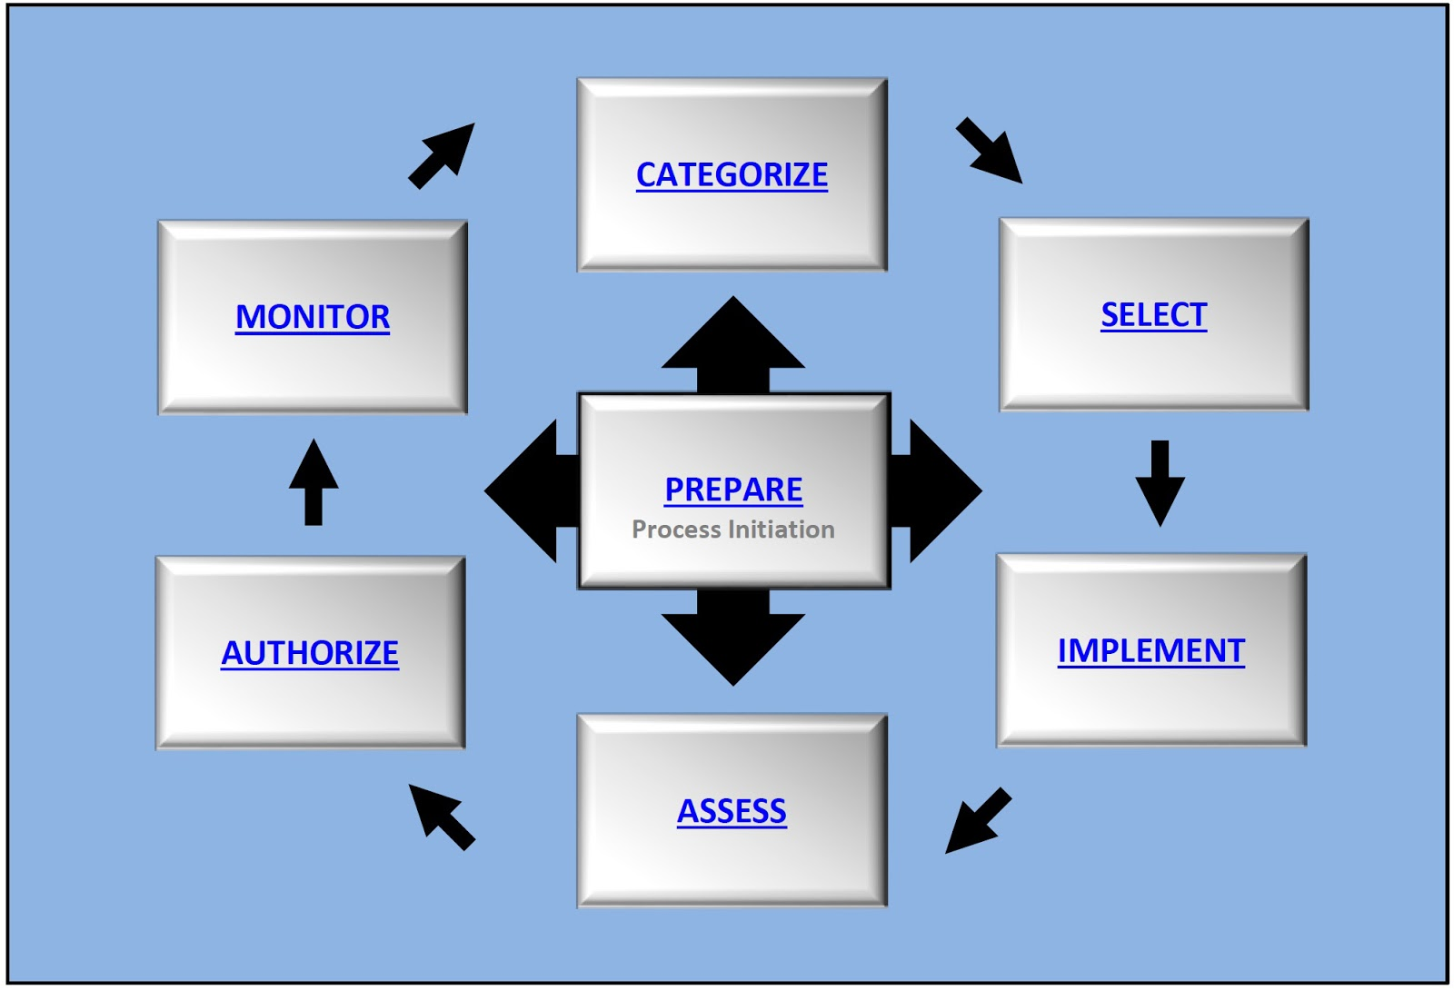
Risk Management Framework
RMF has Seven Steps:
Prepare: Establish Context and Priorities to manage Security and Privacy Risk
Categorize: System and Data based on Impact of Loss
Select: Set Baseline Security Controls Reducing Risk to Acceptable Levels
(NIST, 2013)
Implement: Document the Controls Implementation Process
Assess: Are the Controls Satisfactory for Security and Privacy Requirements
Authorize: If Controls are at the Acceptable Risk Level
Monitor: System and Controls, Documenting Changes, Conducting Risk Assessments and Reporting on Security and Privacy Posture
Reasons to adopt the RMF
Other Industries are Adopting the RMF: Defense (DFARS), healthcare (HIPAA) and retail/payment (PCI).
30-50% of U.S. Companies currently use the RMF as their standard for data protection (GOVFTP, 2019)
The RMF gives a Comprehensive Security Picture for planning a Risk Management Strategy
RMF can be applied to this organization as it is exceptional for Industries with critical and highly sensitive data.
The RMF Provides extensive documentation. Government Publications provide clear instructions making the process more methodical, standard and less costly
The RMF may be a future mandated regulation. Adopting it now will keep Equifax ahead of future regulations, thereby reducing future costs
(Lang, 2019)

Slide 7

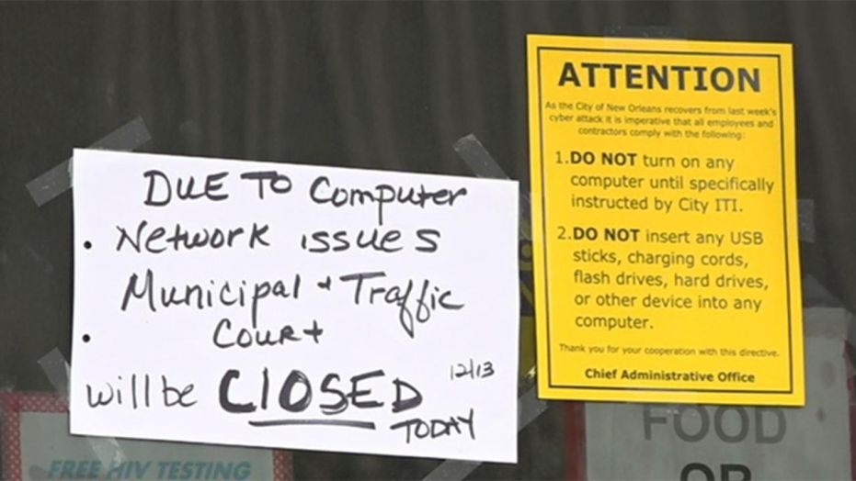
Business Continuity Plan: How to address downed systems, natural disaster, cybersecurity incidents and human factors Team responses need to be faster, more complete and more direct. Planning is everything
FEMA Business Continuity Planning Suite
Developed by DHS’ National Protection and Programs Directorate and FEMA
Applies to Large and Small Corporations
Can be Supplemented with NIST for Tech
Program Management, Planning, Implementation, Testing, Exercises and Program Improvement
Prepare for Cyber attacks, Social Engineering, Malware, Data Injection and More
Includes Specialized Disaster Recovery Plan
Recommended by The California Hospital Preparedness Association, International Security Network WaterISAC, the Ohiio Bankers League, ReadyWV, RestoreYourEconomy.org, Nashville.gov, NERAC, and Florida.gov
(Department of Homeland Security, 2019)

Slide 8

If an Attacker gains access, how to know and respond
Technology is complex, more than one answer may be required to secure systems
Deterrent and Directive Policies
Attack Mitigation
“Start with physical security, as not all data theft happens online
Restrict access rights-password privacy
Train staff to spot the warning signs and trigger alerts
Patch promptly
Monitoring, log files and change management systems can give you early warning of suspicious activities
Use two-factor authentication to limit the damage of a lost or stolen device
Encrypt sensitive data, so that it is next to useless when being stolen”
(Wilczek, 2018)
Intrusion detection and prevention systems (Solarwinds, Splunk, Sagan, OSSEC, Open WIPS-NG, Fail2Ban, Zeek)
Mitigate DDoS Attacks (Firewalls, Close Monitoring, Imperva)
IT Personnel and Chain of Command Notification
Data Breach Response Plan
Secure operations while securing evidence
Use a Forensics Team and Legal Council
Fix Vulnerabilities-work with Forensics
Notify Appropriate Parties
Notify Law Enforcement
(FTC, 2019)

Slide 9
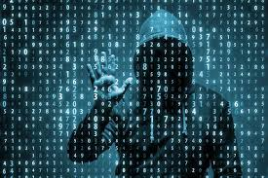
Keeping Systems Secure:
Change Management
Audit and Testing Schedules
This step is where attackers broke in, through certificates that were not updated and renewed, gaining access to office password lists, finally using the Apache Struts Vulnerability-that Corporate Tested for- to steal information.
If the certificates had been renewed, if passwords were kept private, if Apache Struts was known to be one of our critical systems- today would be a different conversation.
Documentation changes needed going forward:
Document all testing and changes before implementation
Final Changes monitored and Documented by IT Personnel
IT Personnel have set chain of command including IT notifications
Alerts set if configurations are Changed without Authorization
Certificates kept up to Date
(NIST, 2011)
Document every Change, Hardware, Software, Updates and Essentials, to keep a complete Asset Inventory List current, without lapse
(U.S. Senate Subcommittee, 2018)
Updates and Patches-Daily
IT Department Audits- Monthly
Outsourced Audits-Quarterly
Intense Pen-testing- Quarterly until passing, Bi-yearly after
New requirements for passwords, resetting every 90 days
(Comtact, 2018)

Slide 10

References
Comtact. (April 17, 2018). How often should you audit your cybersecurity and who should do it? Retrieved December 19, 2019 from https://www.comtact.co.uk/blog/how-often-should-you-audit-your-cyber-security- and-who-should-do-it
Department of Homeland Security. (2019). Business continuity planning suite. Ready.gov. Retrieved December 19, 2019 from https://www.ready.gov/business-continuity-planning-suite
Equifax 2016 Annual Report. (2016). The power of insights. Equifax. Retrieved December 18, 2019 from https://www.equifax.com/assets/corp/2016_annual_report.pdf
Equifax 2018 Annual Report. (2018). Investing for growth and market leadership. EFX. Retrieved December 18, 2019 from https://investor.equifax.com/~/media/Files/E/Equifax-IR/Annual%20Reports/2018-annual- report.pdf
FTC. (April, 2019). Data breach response: A guide for business. Business.ftc.gov. Retrieved December 20, 2019 from https://www.ftc.gov/system/files/documents/plain-language/pdf-0154_data-breach-response- guide-for-business-042519-508.pdf
GOVFTP. (2019). What is NIST? The complete guide to the NIST cybersecurity framework. Retrieved December 19, 2019 from https://www.ftptoday.com/what-is-nist
Lang, Casey. (May 17, 2019). Understanding the NIST risk management framework (RMF). Cybershealth Services International. Retrieved December 19, 2019 from https://cybersheath.com/understanding-the-nist- risk-management-framework-rmf/?gclid=Cj0KCQiAuefvBRDXARIsAFEOQ9HXd4FZZKNT2NuM4SFXHFBOwMcRGsal7Je4r1WIDwWMnjYHHhpvGw0aAobUEALw_wcB
NIST. (October 2008). Security considerations in the system development life cycle. Gaithersburg, MD: U.S. Department of Commerce.
NIST. (2011). Configuration change control. Special Publication CM-3. Retrieved December 20, 2019 from https://nvd.nist.gov/800-53/Rev4/control/CM-3
NIST. (September, 2012). Guide for conducting risk assessments. Gaithersburg, MD: U.S. Department of Commerce
NIST. (April 2013). Security and Privacy Controls for Federal Information Systems and Organizations. U.S. Department of Commerce. Retrieved December 11, 2019 from https://nvlpubs.nist.gov/nistpubs/SpecialPublications/NIST.SP.800-53r4.pdf
NIST. (December 2018). Risk Management Framework for Information Systems and Organizations. Gaithersburg, MD: U.S. Department of Commerce
U.S. Senate Subcommittee. (2018). How Equifax neglected cybersecurity and suffered a devastating data breach. Permanent Subcommittee on Investigations: United States Senate
Wheeler, E. (2011). Security risk management: building an information security risk management program from the ground up. Waltham, MA: Syngress
Wilczek, Marc. (2018). The eight most common cyber-threats, and how to mitigate them. Compare the Cloud.net. Retrieved December 19, 2019 fromhttps://www.comparethecloud.net/articles/eight-most-common- cyber-threats/

